Slide 1
Patterns in software development
Ronnie Holm
Lecture 7

Slide 2
Agenda
Origin of design patterns
Categories of software patterns
Architectural pattern
Design pattern
Idiom pattern

Slide 3
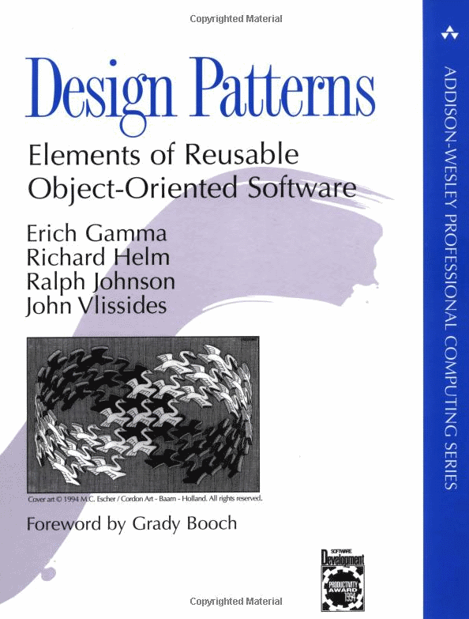
Origin of design patterns
The original book on design patterns published in 1994
Written by the famous “Gang of Four”
Contains 23 “classic” patterns
Notes:
- Good book, given what is was trying to do and when it was doing it - Strong emphasis on C++ and OOP - Describes a lot of useful ideas which got corrupted by people who misapplied it - Some people say design patterns is a flaw in your language. If you need design patterns, your language is broken - Once upon a time the subroutine call was just a pattern - If you were writing machine code you knew you’d have to push some values onto a stack and then jump to another address - Patterns exist at all levels of programming - http://www.infoq.com/presentations/Clojure-Design-Patterns

Slide 4
Categories of software patterns
Architectural patterns
Design patterns
Idiom patterns

Slide 5
Architectural pattern
“An architectural pattern expresses a fundamental structural organization schema for software systems. It provides a set of predefined subsystems, specifies their responsibilities, and includes rules and guidelines for organizing the relationship between them.” (POSA)
Notes:
- Categories originate form the “Patterns-Oriented Software Architecture” series of books - Describes an entire computer system - Agnostic about the language you’re writing in. They’re describing how subsystems fit together

Slide 6
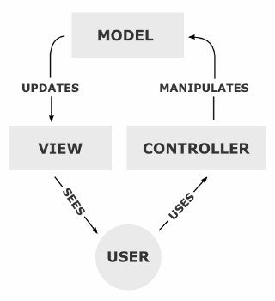
Model-view-controller
Separates the representation of information from the user's interaction with it
Divides application into three kinds of components and define their interactions
Front-end layer
Back-end layer
DTOs define protocols between layers
View ↔ DTO ↔ Controller ↔ DTO ↔ Model
Middle layer

Slide 7
Design pattern
“A design pattern provides a scheme for refining the subsystems or components of a software system, or the relationships between them. It describes a common-recurring structure of communicating components that solves a general design problem within a particular context.” (POSA)
Notes:
- What people tend to associate with the term pattern in software - Describes how things happen within a single component - How program is structured, how execution flows, how data flows

Slide 8
Singleton pattern
Restricts the instantiation of a class to one object
Useful when exactly one object is needed to coordinate actions across the system
public class Singleton {
private static Singleton _instance;
private Singleton() { }
public static Singleton Instance {
get {
if (_instance == null) {
_instance = new Singleton();
}
return _instance;
}
}
}
class Program {
public class Program {
static void Main(string[] args) {
Singleton s1 = Singleton.Instance;
Singleton s2 = Singleton.Instance;
Console.WriteLine(
Object.ReferenceEquals(s1, s2));
}
}
}
Notes:
- Often considered an anti-pattern because it stores global state - Introduces unnecessary restrictions in situations where a sole instance of a class is not actually required - Singletons are often preferred to global variables because - They do not pollute the global name space with unnecessary variables - They permit lazy allocation and initialization, whereas global variables in many languages will always consume resources
- Concept is sometimes generalized to systems that operate more efficiently when only one object exists - Term comes from mathematical concept of a singleton - The singleton pattern must be carefully constructed in multi-threaded applications - This pattern makes unit testing far more difficult, as it introduces global state into application - Reduces the potential for parallelism within a program, because access to the singleton in a multi-threaded context must be serialized - http://ericlippert.com/2013/02/21/monads-part-one/ - C# does not have the "singleton" pattern "baked in" to the language - It could have been; there could be special syntax for singleton class C { ... }, as there is for static classes or abstract classes - Designers did not consider it an important enough pattern to be elevated into the language as a first class feature

Slide 9
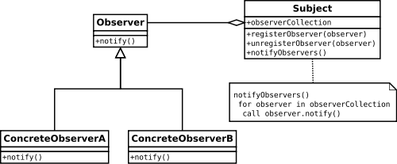
Observer pattern
An object, called the subject, maintains a list of its dependents, called observers, and notifies them automatically of any state changes
Notes:
- Decouples subjects and observers

Slide 10
Template pattern
Defines the program skeleton of an algorithm in a method, deferring some steps to subclasses
Lets one redefine certain steps of an algorithm without changing the algorithm's structure
Notes:
- Template Method pattern occurs frequently, at least in its simplest case, where a method calls only one abstract method - One or more algorithm steps can be overridden by subclasses to allow differing behaviors while ensuring that the overarching algorithm is still followed - The Template Method pattern thus manages the larger picture of task semantics - Calls abstract and non-abstract methods for the task at hand - Some or all of the abstract methods can be specialized in a subclass - Used in frameworks, where each implements the invariant parts of a domain's architecture, leaving "placeholders" for customization options - Implements the Hollywood principle

Slide 11
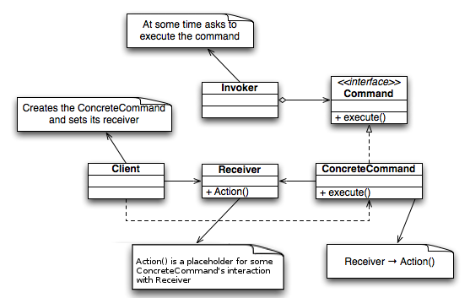
Command pattern
An object is used to represent and encapsulate all the information needed to call a method at a later time

Slide 12
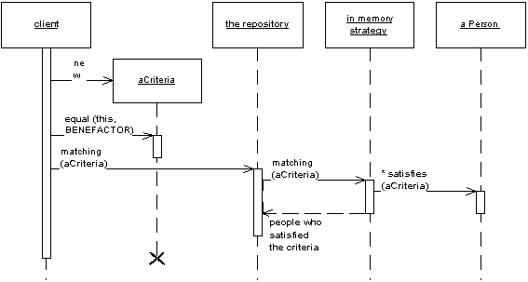
Repository pattern
Mediates between domain and data mapping layers using a collection-like interface for accessing domain objects
Notes:
- Acts like an in-memory domain object collection - Isolates domain objects from details of database access code - It can be worthwhile to build another layer of abstraction over the mapping layer where query construction code is concentrated - Adding this layer helps minimize duplicate query logic - Client objects construct query specifications declaratively and submit them to Repository for satisfaction - Provides a more object-oriented view of the persistence layer

Slide 13
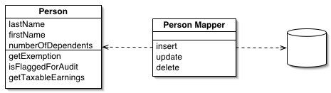
Data mapper pattern
Layer of mappers that moves data between objects and database while keeping the two independent of each other and the mapper itself
Objects and relational databases have different mechanisms for structuring data
Notes:
- Many parts of an object, such as collections and inheritance, aren't present in relational databases - Impedance mismatch - The object schema and the relational schema don't match up - Need to transfer data between the two schemas, and this data transfer becomes a complexity in its own right - If the in-memory objects know about the relational database structure, changes in one tend to ripple to the other - Separates the in-memory objects from the database - Transfer data between the two and also to isolate them from each other

Slide 14
Idiom pattern
Idiomatic means following the conventions of the language
Find easiest and common ways of accomplishing a task rather than porting your knowledge from a different language
“An idiom is a low-level pattern specific to a programming language. An idiom describes how to implement particular aspects of components or the relationships between them using the features of a given language.” (POSA)
Notes:
- Specific to a programming language - An implementation of a pattern - Smaller localized patterns seen in a programming language - Idiomatic code is code that does a common task in the common way for your language - It's similar to a design pattern, but at a much smaller scale

Slide 15
Properties idiom
class Person {
// non-idiomatic string _name; public string GetName() { return _name; } public void SetName(string name) { _name = name; }
// idiomatic
public string Name { get; set; } }

Slide 16
Iterator idiom
public class Program {
static void Main(string[] args) {
List<string> a = new List<string>{ "a", "b", "c" };
// non-idiomatic
IEnumerator e = a.GetEnumerator();
while (e.MoveNext()) {
Console.WriteLine(e.Current);
}
// idiomatic
foreach (string s in a) {
Console.WriteLine(s);
}
}
}

Slide 17
Resource management idiom
public class Program {
static void Main(string[] args) {
// non-idiomatic
StreamReader sr1 = File.OpenText("path to file");
string content1 = sr1.ReadToEnd();
sr1.Close();
// idiomatic
string content2 = "";
using (StreamReader sr2 = File.OpenText("path to file")) {
content2 = sr2.ReadToEnd();
}
}
}

